Slide 1



When you want the best care after you for parents, then choose Grace Garden
+91-91007 773861

Slide 2

If you worry about your parents when you’re away.. Grace Garden gives peace of mind everyday.
+91-91007 773861

Slide 3
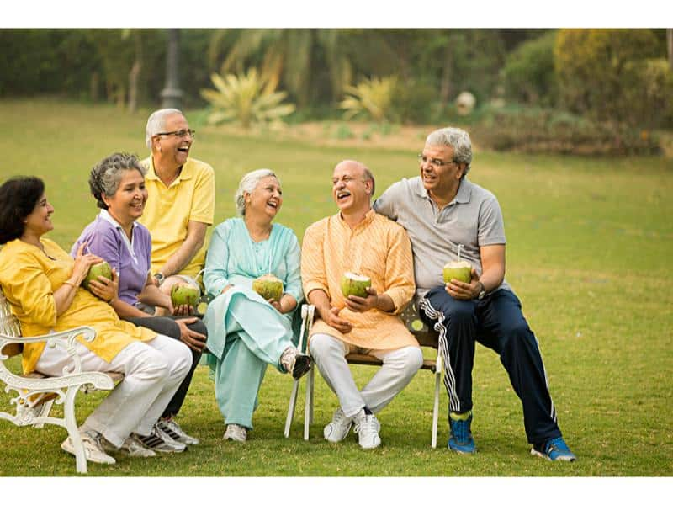
For Families who want dependable, respectful senior care – Grace Garden is the answer.
+91-91007 773861

Slide 4

When your parents need genuine care, we become your extended family.
+91-91007 773861

Slide 5
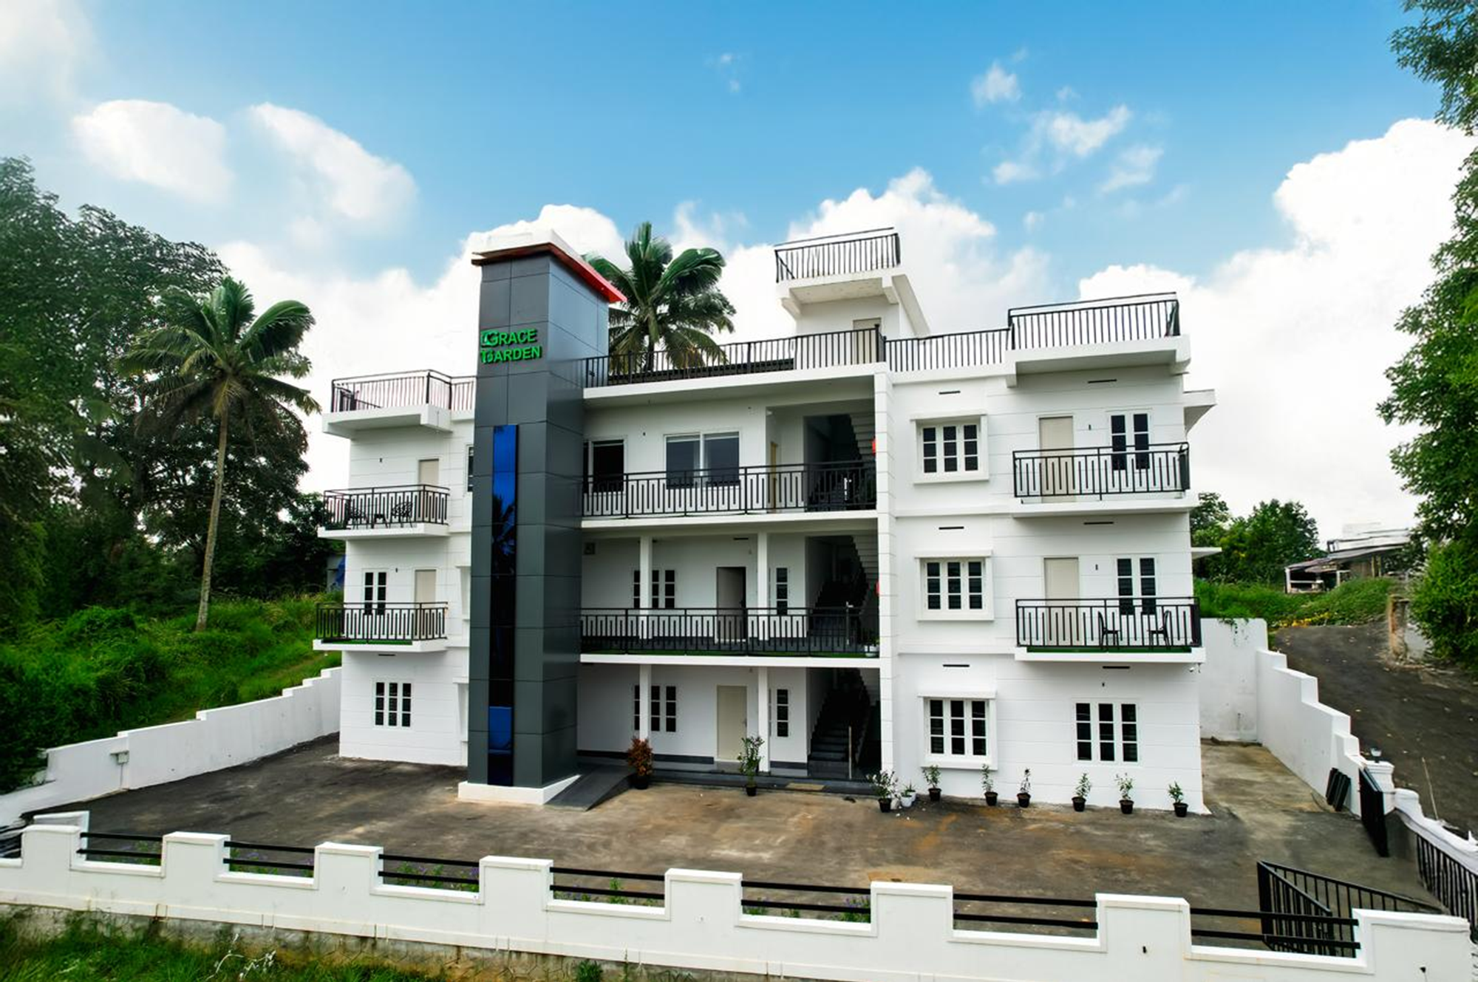
Bring them to a place where care feels like family – Grace Garden.
+91-91007 773861

